Slide 1

Daily Mart Ecommerce website
Submitted By
Md Nur A Neouse
ID: 193002093
Jakirul Islam
ID: 193002101
Nazifa Alam Nowrin
ID:193002103
Department Of CSE
Green University of Bangladesh
Submitted To
Feroza Naznin
Lecturer
Department of CSE
Green University of Bangladesh

Slide 2
Content:
What is a website ?
Project Introduction
Necessity of a Daily mart e-commerce website
Features of this website
Development
Scope of future work
Reference
Conclusion

Slide 3

What is a website?
A collection of publicly accessible, interlinked web pages
shares single domain name
created by an individual or groups
serve various purposes

Slide 4
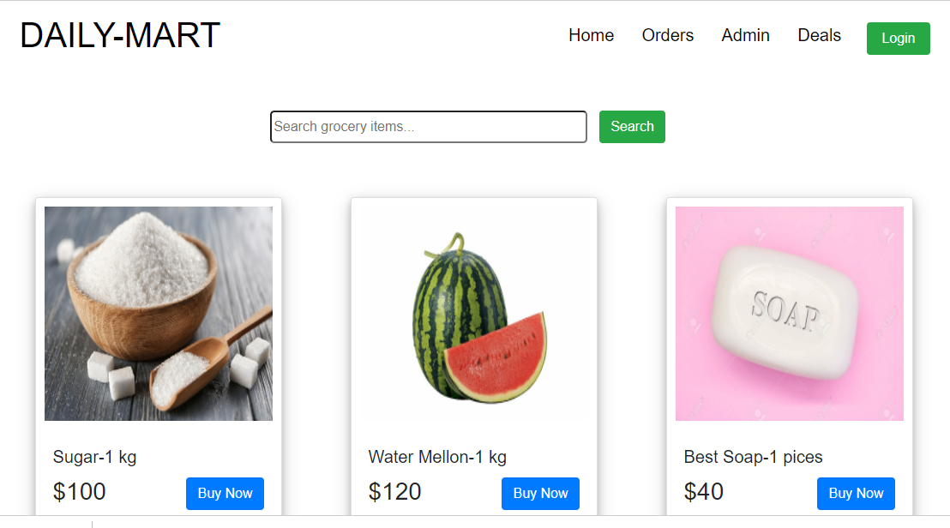
Project Introduction:

Slide 5
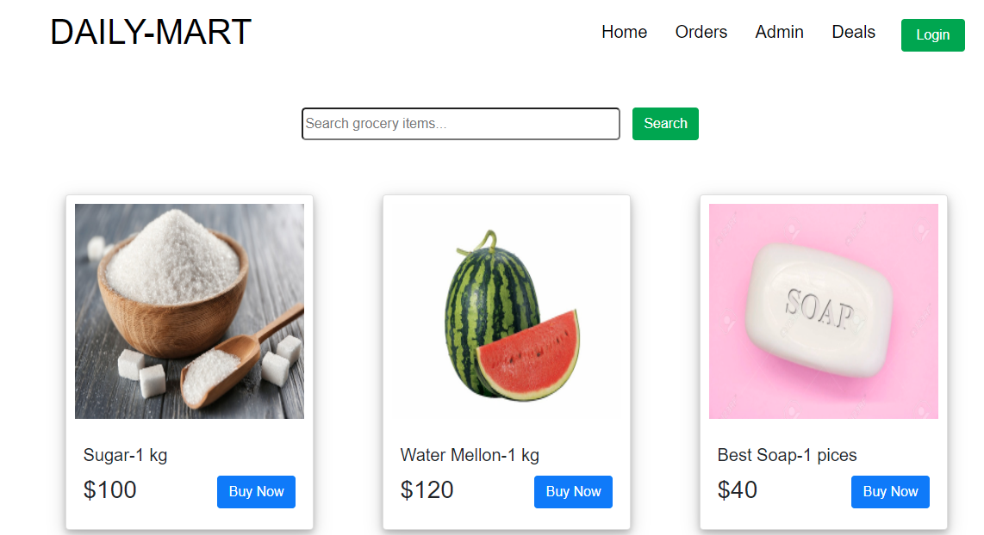
Features of this website:
Authentication System
Admin dashboard
User Dashboard
Payment Gateway

Slide 6
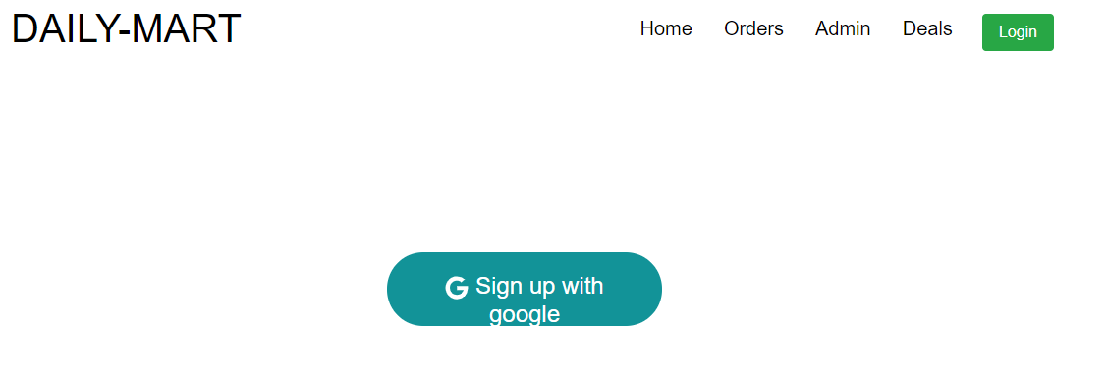
Authentication System:
In Our website we used Google sign in for the authentication system and user registration. If an user or an admin want to go to the dashboard or want to access the private route he must be authenticated first then he will access it.

Slide 7
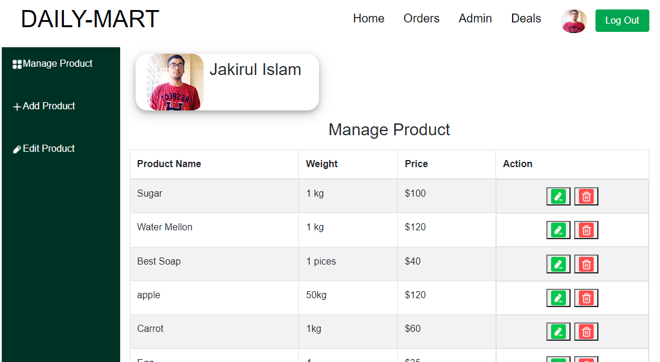
Admin Dashboard:
Manage product
Add Product

Slide 8
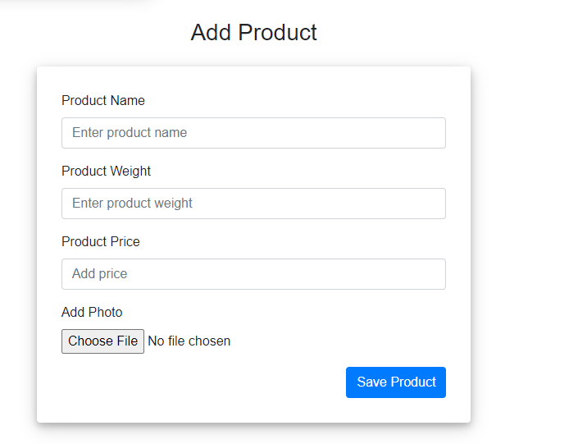
Admin Dashboard:

Slide 9
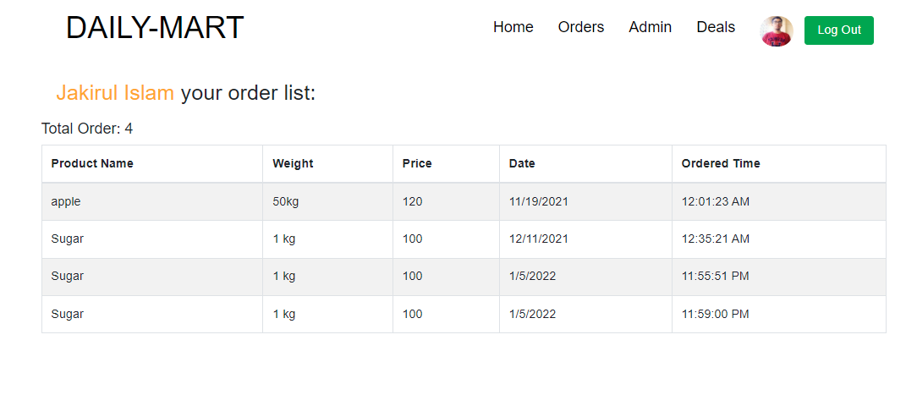
User Dashboard:

Slide 10

Development:
For developing this project we used some trending technology as we mentioned before.
We used React for the full front end of this project and most of the functionality we did with react.
For the backend we used node.js which is a javaScript runtime and we also connect mongoDB database with node.js.
Developing this project is not so easy for us. We taken a lot of help from interntet resources.

Slide 11
Necessity of a Daliy mart ecommerce website
Faster buying process.
Store and product listing creation.
Cost reduction.
Affordable advertising and marketing.
Flexibility for customers.
No reach limitations.
Product and price comparison.
Faster response to buyer/market demands.

Slide 12
Scope of future work:
There are lots of scope in this project for future work.
We will add github, facebook , and email password authentication system.
We will add more feature in user and admin dashboard.
We will add more route like contact , about us and etc.

Slide 13
Reference:
https://reactjs.org/
https://nodejs.org/en/
https://www.mongodb.com/
https://expressjs.com/
https://www.npmjs.com/package/nodemon
https://react-icons.github.io/react-icons/

Slide 14
Thank You

